Slide 1
ORIGINALITY
New Perspective
VISUAL STYLE
Plays with form and conventions
SUBJECT
Cultural and social relevance to audiences
STORY
Incredible Access, Unique Story
VISION
Articulate this concisely

Slide 2
DO
Leave yourself plenty of time to make an application.
Be aware that funders have tight schedules to read large volumes of applications to assess ranging from 150 to 500 at a time.
Read all the information provided about the funds - that includes deadlines, criteria, application process etc. With documents that you have been asked to read such as guidelines and tests to assess your eligibility, READ THE GUIDELINES AND COMPLETE THE TESTS.
CHECK YOUR APPLICATION AND CHECK AGAIN BEFORE SUBMITTING.
*Do the 1-min video! It's one of the most best ways to communicate your ideas. We love seeing the passion of filmmakers and its often really useful for applicants who might be struggling to articulate what they're going for in the written portion, especially if the language your are writing in is not your first language.
Keep to the word limit and say what you mean.
When we ask for a budget, we're aware that this budget might change - we don't mind! - we just need to see that you have realistic expectations for your project.
Be honest! Your application is being viewed by experienced people we can sense when something's not quite right and we will look into it.
PUT IN THE EFFORT! A sloppy application that don't answer the questions asked suggests that the film is not a the right stage and that you might not be ready to make it.
Get in touch (within a reasonable time frame) - we are here to help.

Slide 3
DON’T
Don't worry if you don't have all the answers or if things change. This is the nature of documentary - it's a long process and its ever-changing.
Don’t get in touch about your application after the deadline has passed. You will be refused an extension (unless under special circumstances).
Don't try and bypass the word limit (such as including Google links in answer to every question). Your project will be rejected.
Please do not just copy and paste from a prepared treatment. Answer the questions properly.
Don't exaggerate or lie in your application.
Don't apply if your project is unsuitable/doesn't fit the brief of a particular fund.
Don't abandon your project because you didn't receive funding. We don't give feedback to applications because of the huge volume of applicants in comparison to the small teams who review and select. More often than not, there is nothing wrong with your application, its the simple fact that on average only about 6% of all applications received get funding.
Don't lose heart.

Slide 4
]
Notes:
https://docsociety.org/funds/

Slide 5
Notes:
https://docsociety.org/bfi-doc/

Slide 6
Mentoring emerging filmmaking talent: £11,250 to make a creative doc short under 40mins
Creative and editorial assistance
Partnership with post-production service Encouraging collaborative working practices.

Slide 7
Other Funds
CIRCLE FUND:
A fund supporting the creative visions of filmmakers globally. Made possible by a group of family foundations and individual philanthropists.
FLEX FUND A joint initiative by Skoll Foundation, Ford Foundation and BRITDOC, Flex Fund supports innovative and creative projects emerging from partnerships between moving image storytellers and social entrepreneurs.
Forest Trends, Health Leads, Imazon
THRESHOLD & PERSPECTIVE FUNDS In addition to our funding activities, we also make recommendations to two other foundations. Inviting applications from high profile feature documentaries with the ability to create lasting social impact in accordance with the Foundations’ mission. Oscar-winning The White Helmets Whose Streets Hale County (This Morning, This Evening)

Slide 8
FILMS SUPPORTED THROUGH OTHER FUNDS:
CIRCLE CHASING CORAL BISBEE ‘17
CITIZENFOUR
THE POSSIBILITIES ARE ENDLESS THE INVISIBLE CITY THRESHOLD
DARK MONEY
HALE COUNTY THIS MORNING, THIS EVENING
MIDNIGHT TRAVELER KNOCK DOWN THE HOUSE WHITE HELMETS ROLL RED ROLL

Slide 9
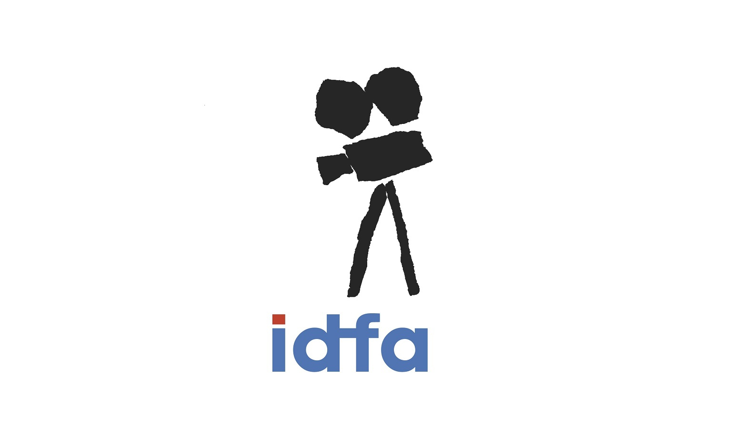
IDFA BERTHA FUND: The IDFA Bertha Fund supports independent, critical, and artistic voices from Africa, Asia, Latin America, the Middle East, and Eastern Europe (IBF regions). The Fund provides development, production, and distribution grants through two funding schemes.
IBF Classic
IBF Europe – Distribution of International Co-productions
IDFA FORUM:
IDFA Forum is one of the most influential meeting places for filmmakers, creators, and producers working on ground-breaking creative documentaries and new media projects. The first of its kind, the Forum gathers some of the strongest documentary projects currently being developed and produced globally, and presents them in a compact four-day program of public presentations and one-on-one meetings.
The Forum takes place during the IDFA Festival in November. 5 Broken Cameras

Slide 10
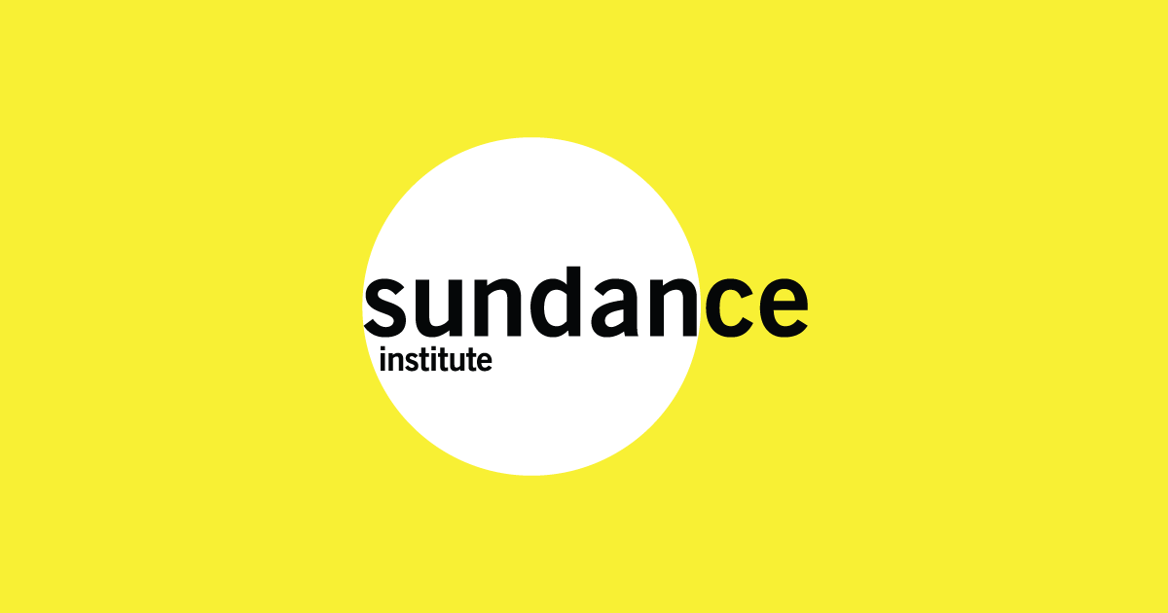
The Sundance Institute Documentary Film Program supports nonfiction filmmakers worldwide in the production of cinematic documentaries on contemporary themes.
Recent projects include Joshua Oppenheimer’s The Look of Silence; Laura Poitras’s CitizenFour; Feras Fayyad’s Last Men In Aleppo; RaMell Ross’s Hale County This Morning, This Evening; Kirsten Johnson’s Cameraperson; Yance Ford’s Strong Island; and Raoul Peck’s I Am Not Your Negro.
Documentary Fund
The Documentary Fund has a rolling open-call. Submissions are accepted year-round.
Special Opportunity Funds
The Documentary Fund offers additional support for projects that address specific pressing socio-cultural issues, through our partners. Projects selected for these opportunities will be fielded through our general Documentary Fund application.
A&E Brave Storytellers Fund
The Kendeda Fund
Science Sandbox Nonfiction Project
Luminate Fund

Slide 11
dok.incubator invites editors, directors and producers to a six–month long workshop, focused on filmmakers’ professional development and giving you access to top internationally-experienced tutors.
Be aware that all three team members – director, editor and producer – must be available to participate in three one-week residential sessions in April/May, June and September. You cannot apply without an editor.
You will attend three one-week residential sessions at different project development stages (the dates and locations will be confirmed later)
Previous projects: Thank You For the Rain, Edge of Democracy

Slide 12
The Gucci Tribeca Documentary Fund provides finishing funds to feature-length documentaries which highlight and humanize issues of social importance from around the world. The Gucci Tribeca Documentary Fund is geared towards feature documentaries, based anywhere, that are in production or post-production with no intended premiere exhibition date:

Slide 13
CPH:FORUM is CPH:DOX’s financing and co-production event dedicated to facilitate the development and financing of creative and visually strong film projects with international potential, whether they are features, series or new media projects.
Eurimages Co-Production Development Award of €15,000 for the events best pitch. Also, we are excited about our continued collaboration with Kickstarter, who will be onboard to provide guidance and promotional support for all film projects that are participating in CPH:FORUM, including campaign strategy and outreach, tailored guidance for specific projects, press support and promotion.
Reflecting the overall profile of CPH:DOX, projects at CPH:FORUM are presented within five main categories:
FICTIONONFICTION: Challenging works in the hybrid landscape between fiction and non-fiction.
CINEMA: High-end theatrical feature-length documentaries with international distribution potential.
F:ACT: Projects bridging the fields of filmmaking, investigative journalism and activism.
ART: Film projects positioned in the borderland between art and film and screened both within the institution of cinema and that of visual arts.
SCIENCE: Creative documentary film and new media projects on science and technology.

Slide 14
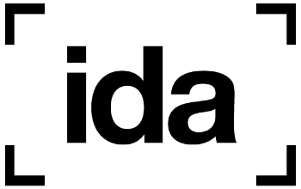
While the IDA’s funds are US targeted, they have a great global funding database: https://airtable.com/shrXiCFbXtjL04ZQY/tbl71vFUL804eGbkz/viwVFi9vq6VX91oQq?blocks=hide

Slide 15
Our programs support women* nonfiction filmmakers at various stages in their careers.
We support filmmakers from diverse backgrounds who are both committed to social change and to the art and craft of filmmaking. When we choose a project, it is because we believe the film needs to be made–and that the particular filmmaker is the one to make it. Our grantees have unique access to their subjects, a collaborative spirit, and the courage to take creative risks.
PROJECT: HATCHED
Project: Hatched is Chicken & Egg Pictures’ completion fund, designed to support nonfiction directors as they prepare for the world premiere of a feature-length documentary film and develop a strategic impact and audience engagement campaign.
CHICKEN & EGG
PICTURES
DOCS BY THE DOZEN
Docs by the Dozen recognizes the power of documentary shorts.
Docs by the Dozen was designed to engage with the 300+ members of our AlumNest, build meaningful partnerships with like-minded organizations and media companies, and generate artistic and innovative short films and series that can increase a filmmaker’s financial stability.
(EGG)CELERATOR LAB: The (Egg)celerator Lab (formerly the Accelerator Lab) is focused on identifying and supporting nonfiction directors working on their first or second feature-length documentary. This program brings together ten projects, with a special focus on self-identifying women and gender non-conforming directors.

Slide 16
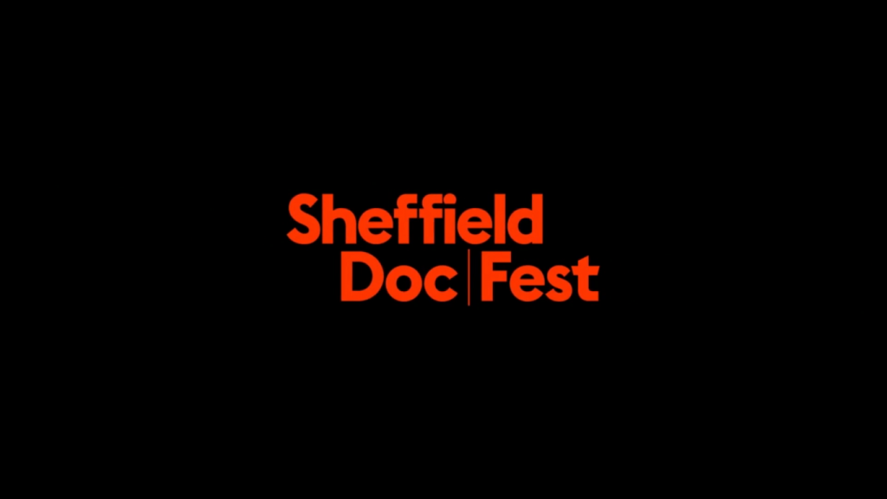
The MeetMarket is one of the world’s largest documentary and factual markets and pitching forums. Selected projects will have the opportunity to meet with top Decision Makers among 300+ international funders, broadcasters, distributors and exhibitors. The MeetMarket offers a unique way to pitch your project through carefully matchmade meetings between pitchers and Decision Makers, for creative and financial discussions. The MeetMarket is open to all documentary makers, local and international, and we welcome submissions from established, emerging as well as first-time filmmakers. Projects can be in any form ranging from long form to series and formats.
The market gives you the chance to meet with the likes of A+E, ARTE, BBC, Bertha Foundation, Catapult Film Fund, Channel 4, Submarine Entertainment, Curzon, Cinereach, Doc Society, Dogwoof, Field of Vision, The Guardian, Google, National Geographic, NETFLIX, New York Times, PBS, Pulse Films, SKY, Submarine, SXSW, Universal, VICE, and many more companies and organisations who are looking to support and invest in documentary storytelling.
Many internationally successful documentaries have found partners in the MeetMarket while in development, including The Edge of Democracy, Unrest, Searching for Sugarman, The Act of Killing, The Look of Silence, Black Panthers: Vanguard of the Revolution, Mavis!, 5 Broken Cameras, The Story of Film, and many more.

Slide 17
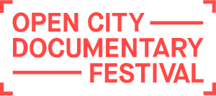
Assembly
Assembly is a development lab for creative documentaries. The programme is a project-based intensive workshop for international filmmakers working on their first or second feature. Participants from six selected projects will attend a four-day programme in London with talks, workshops and one-to-one mentoring followed by a closed pitch for £10,000 development funding. Participants will also be able to attend screenings, talks and networking events as part of Open City Documentary Festival

Slide 18
CrossCurrents Doc Funds:
Promoting inclusion in the documentary space, the CrossCurrents Doc Funds foster storytelling from within groups whose perspectives have been historically underrepresented. The filmmaker’s deep connections to the community will offer a unique perspective on the stories they share.
Development and production grants of $10,000-$30,000 CAD for interactive, short or feature-length films by emerging international storytellers whose perspectives have been historically underrepresented.
North America’s most effective international documentary market, the Hot Docs Forum is a dynamic pitching event that stimulates international co-production financing.
Taking place over two days, pre-selected international projects are presented to a round table of leading commissioning editors, film fund representatives, financiers, programming executives and delegates from around the globe.
Hot Docs-Blue Ice Group Documentary Fund provides development grants of up to 10,000 CAD and production grants of up to $40,000 CAD to four to ten projects annually. Each year, up to five funded projects are invited to participate in a year-long mentorship program, which includes private filmmaker labs at Hot Docs and the Durban FilmMart/Durban International Film Festival or other festivals and markets in Africa.

Slide 20
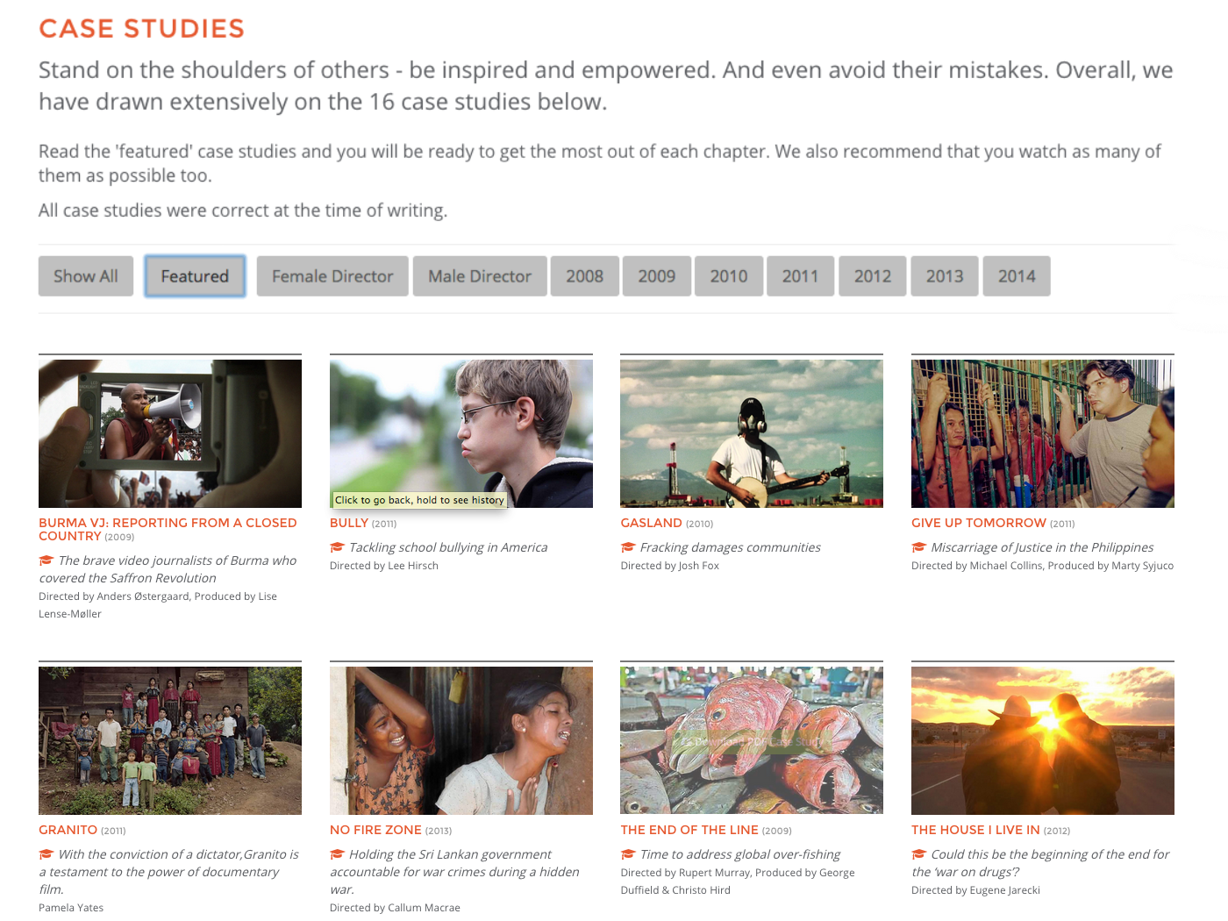

Slide 21
DISTRIBUTION: WHAT ARE MY OPTIONS?
TV:
VOD PAY CABLE SATELLITE DIGITAL
INTERNET:
SINGLE FEE PLATFORM (ITUNES)
SUBSCRIPTION PLATFORM (NETFLIX)
FREE PLATFORMS
APPS
DIRECTLY (MP4, .MOV)
PLAY FOR CLICK (YOUTUBE)
PHYSICAL:
DVD BLU-RAY
SPECIAL EDITIONS
BOOKS
NOVELTIES
THEATRICAL: FESTIVALS
CINEMA CHAINS
INDIE/ARTHOUSE
SPECIAL EVENTS
COMMUNITY SCREENINGS
D.I.Y. SCREENINGS
Notes:
Even if you think you are not interested in creating impact with your film there are modules here on financing, working with contributors, distribution and finding an audience which are essential business skills for any filmmakers so I would encourage everyone to take a look! The Independent Cinema Office is a fantastic resource for UK filmmakers looking to explore ways for their films to be seen in the UK: https://www.independentcinemaoffice.org.uk/advice-support/cinemas/ as well as the Doc Society resources for various help and considerations on the journey of making a film: https://docsociety.org/resources/

